Slide 1

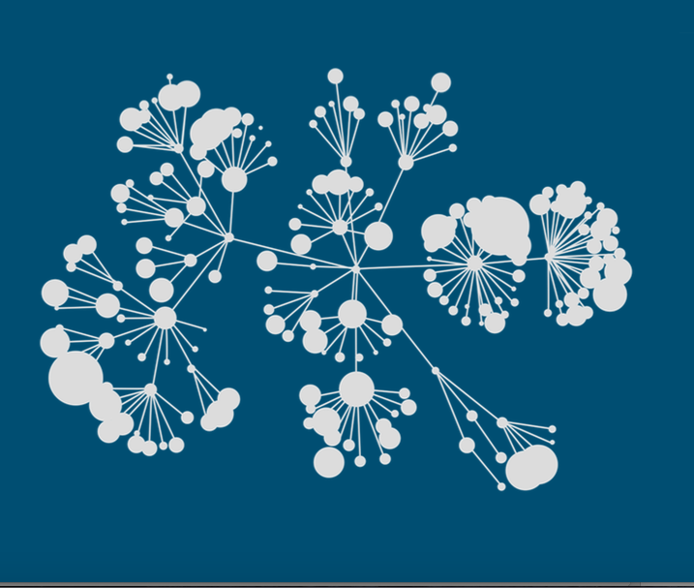
Kaggle
3rd Place Solution to the TalkingData Competition
https://www.kaggle.com/c/talkingdata-mobile-user-demographics
Notes:
Recommending picking out he most interesting and important parts from your documentation.

Slide 2
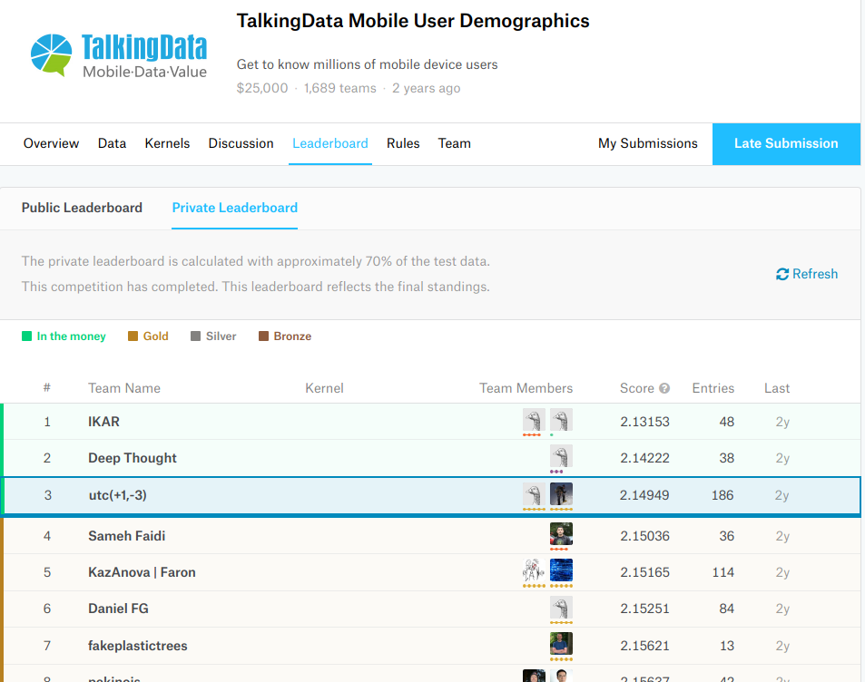
Background

Slide 3
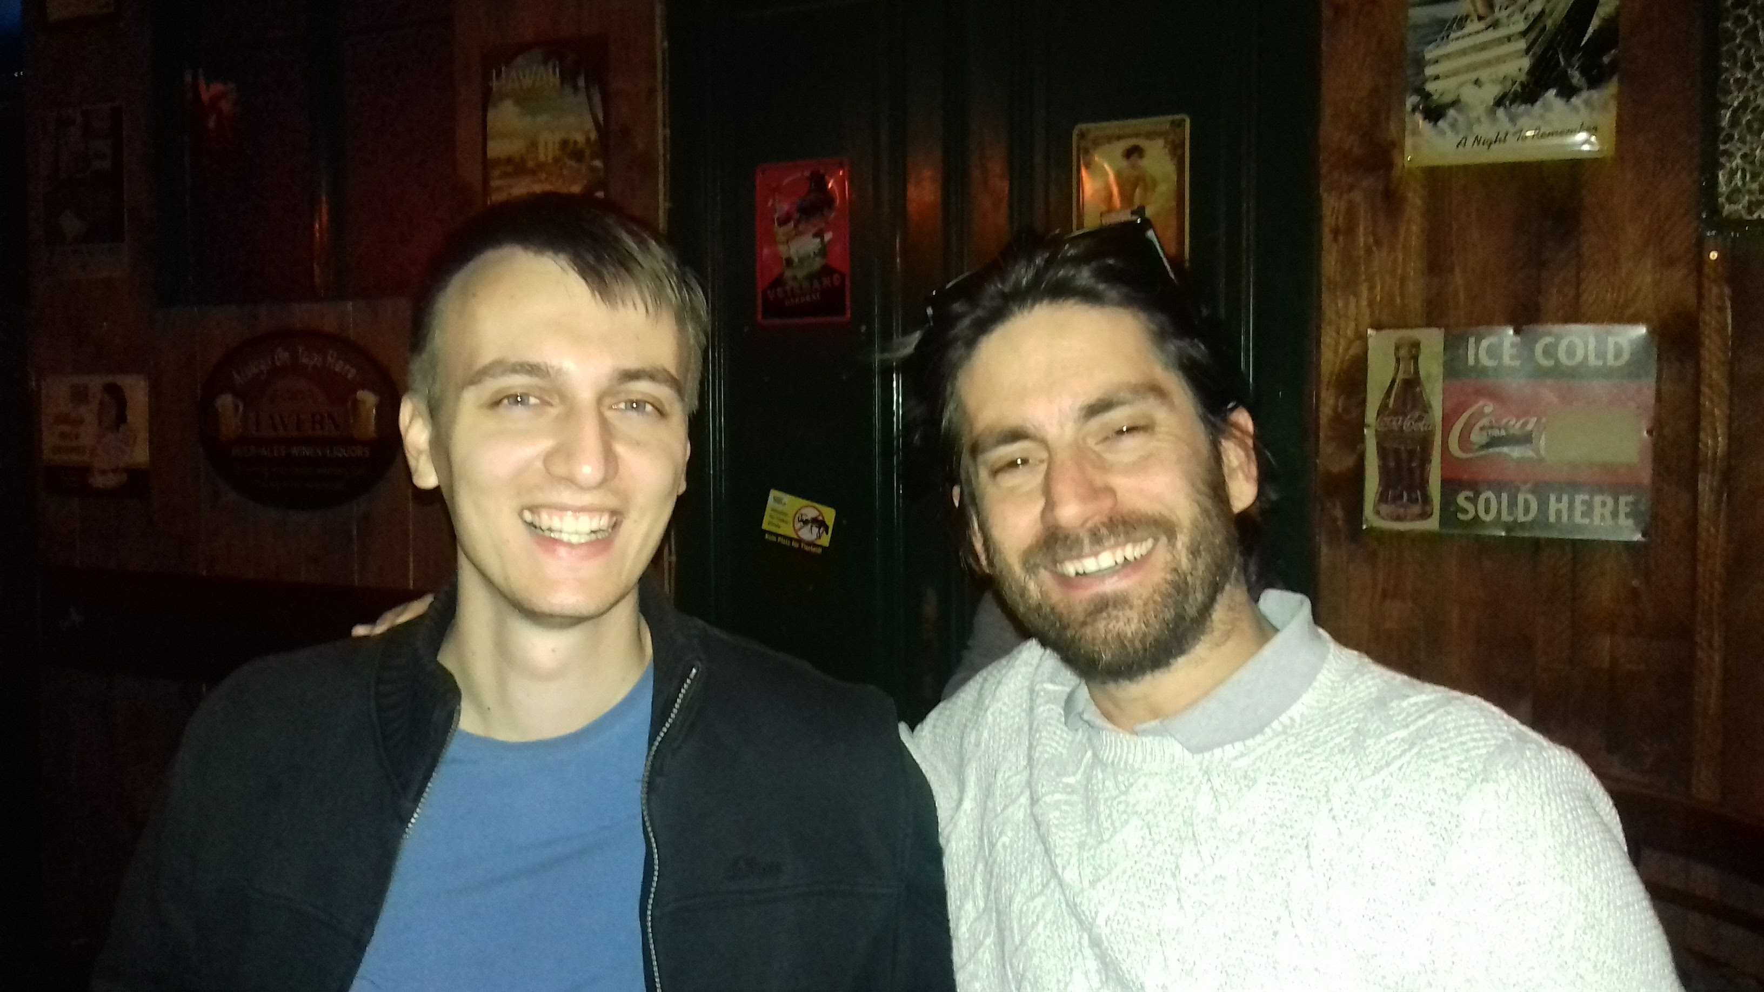
Background
Danijel Kivaranovic
(Austria)
Matias Thayer
(Chile)

Slide 4
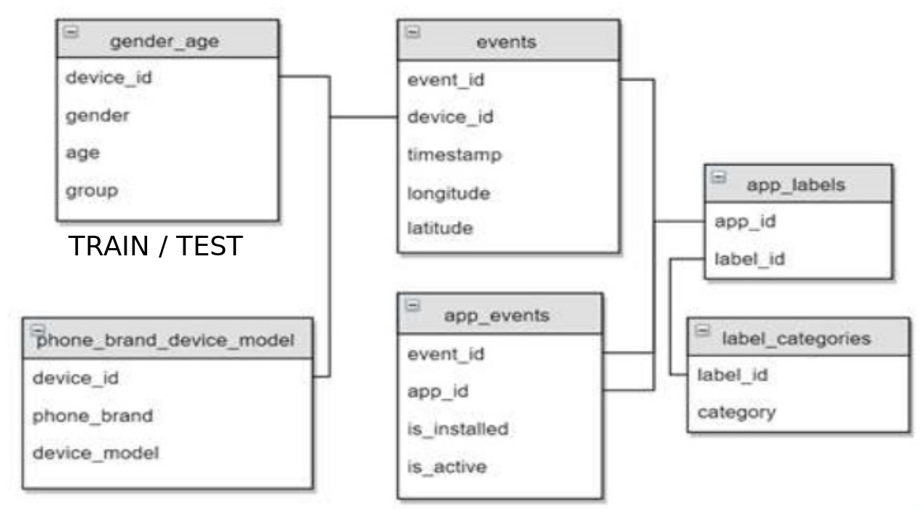
Data Overview
3,252,950
459,943
Target
74,645 /
112,071
186,716
459,943
32,473,067
For 1 device, multiple events.
For 1 event: What apps are installed in the device
Notes:
Example dot points
Most important classifier was XGBoost
The three most important features were car color, make of the car, number of miles
One of my biggest insights was that building a separate classifier for each brand of car gave me a big performance improvement
Used Python (Pandas and XGBoost)

Slide 5
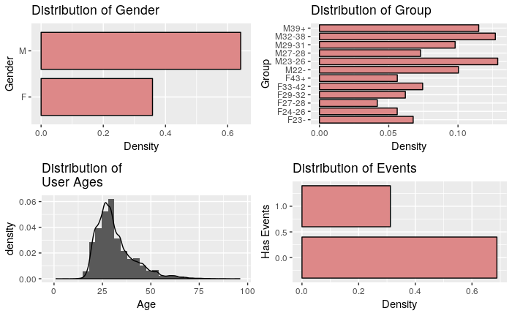
Data Overview
Talking data predicting groups for users of mobile devices
Notes:
Example dot points
Most important classifier was XGBoost
The three most important features were car color, make of the car, number of miles
One of my biggest insights was that building a separate classifier for each brand of car gave me a big performance improvement
Used Python (Pandas and XGBoost)

Slide 6
Summary
The success of our team relies mostly on:
Feature Engineering
Train, and optimise different models for devices with events /without events
Using 2 stage optimisation for mlogloss
Using linear ensembles optimising weights with the optim package (R) in 5 folds CV
Bagged 10 times
Data leak script (Data leaking found at the end in the forum!)
Notes:
Example dot points
Most important classifier was XGBoost
The three most important features were car color, make of the car, number of miles
One of my biggest insights was that building a separate classifier for each brand of car gave me a big performance improvement
Used Python (Pandas and XGBoost)

Slide 7
Feature Engineering:
1HE for brands, models, and app_id (sparse matrix)
Using the csr_matrix constructor (SciPy)
Features Selection / Engineering
csr_matrix( (data, (row_ind, col_ind)), [shape=(M, N)])
where "data", "row_ind" and "col_ind" satisfy the
relationship "a[row_ind[k], col_ind[k]] = data[k]

Slide 8
Simple 1 hot encoding with sparse matrix
ix | device_id | brand
0 | 1 | Iphone (0)
1 | 2 | Iphone (0)
2 | 3 | Nokia (1)
3 | 4 | Nokia (1)
4 | 5 | Samsung (2)
Features Selection / Engineering
0 1 2
0
1
2
3
4
[[1., 0., 0.],
[1., 0., 0.],
[0., 1., 0.],
[0., 1., 0.],
[0., 0., 1.]]
csr_matrix( (data, (row_index, col_index)), [shape=(M, N)])
data [1 1 1 1 1]
row_index [0 1 2 3 4]
col index [0 0 1 1 2]
M = 5
N = 3

Slide 9
Grouped 1 hot encoding with sparse matrix
ix | device_id | event_id | app
0 | 1 | 5 | EDX (0)
0 | 1 | 5 | Runtastic (1)
0 | 1 | 4 | Runtastic (1)
1 | 2 | 3 | EDX (0)
1 | 2 | 3 | WeatherApp (2)
Features Selection / Engineering
0 1 2
0
1
2
3
4
[[1., 1., 0.],
[1., 0., 1.],
[0., 0., 0.],
[0., 0., 0.],
[0., 0., 0.]]
csr_matrix( (data, (row_index, col_index)), [shape=(M, N)])
M = 5
N = 3
data [1 1 1 1]
row_index [0 0 1 1]
col index [0 1 0 2]
Distinct devices
Distinct apps

Slide 10
Applying this for all apps events in every device, we get:
Train: 74,645 x 19,237 sparse matrix of type
With 915,632 stored elements
in Compressed Sparse Row format (0.06%)
Features Selection / Engineering
Test: 112,071 x 19,237 sparse matrix
With 1,387,337 stored elements
in Compressed Sparse Row format (0.06%)
Traditional Matrix: 2,155,909,827

Slide 11
Other feature engineering:
TF-IDF of brand and model + labels(with events)
Counts for apps, categories, brands and model names
Calculate median latitude and longitude of events.
Count at which hour and at which weekday the events happened.
Ratios of label categories for a given device
Flag indicating if the device has event data
Features Selection / Engineering
TF-IDF is a numerical statistic that is intended to reflect how important a word is to a document in a collection of corpus

Slide 12
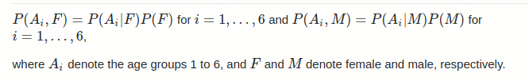
2-Stage optimization for mlogloss:
Improved xgboost performance.
Good for devices with no events.
Predict the probability of gender (Stage 1)
Use gender as additional feature and predict the probability of age groups (Stage 2)
Combine the predictions using the definition of conditional probability:
Logloss optimization variant

Slide 13
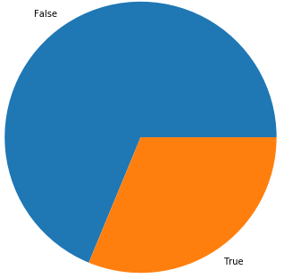
Training Methods
Independent models and optimizations for devices with events and devices without events
Without events:
Train using all devices, but less features
31% with events.
Train using only these devices

Slide 14
MODELS
Matias / NNET + Regression (1 model)
Matias / NNET (1 model)
Matias / Xgboost (3 models)
Matias / Elastic net
Danijel / Xgboost 2 stages (1 model)
Danijel / NNET (3 models)
Libraries: Keras, sk-learn, xgboost (python), Glmnet
Training time: ranges from 2 to 12 hours
Training Methods

Slide 15
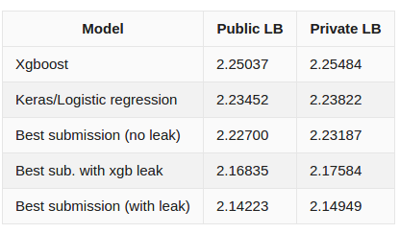
Leaderboard Performance Chart

Slide 16
Learnings?
Focus more on the data
Leave complicated ML stuff to the end
Read the forum regularly
Optimise your time:
Keep your code clean
Leave blends of blends of blends to the end
Share ideas in the forum!
Learnings

Slide 17
Thank you!
Questions?

Slide 18
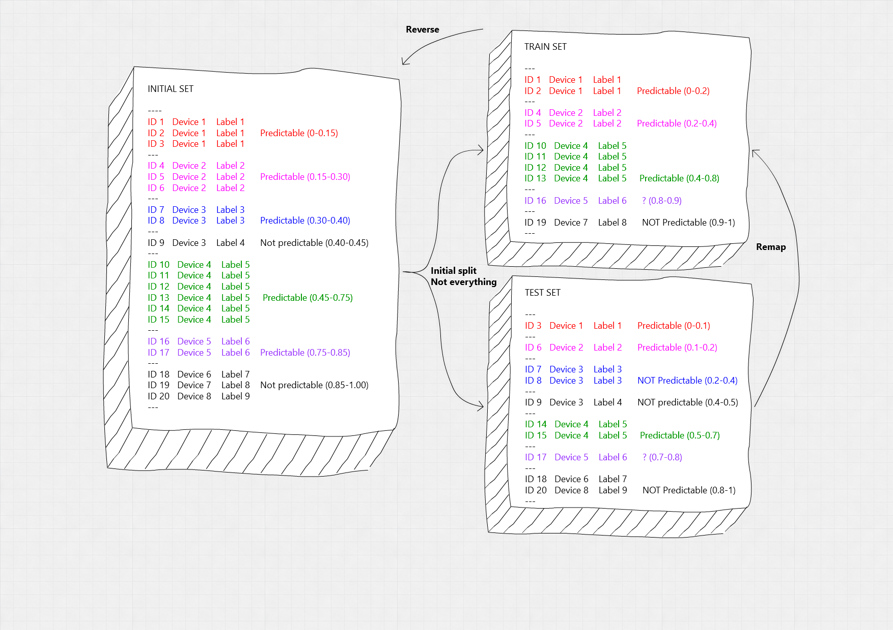

Slide 19
